Slide 1

AWS Key Management Service (KMS):
Securing Your Cloud Encryption Keys
A comprehensive overview of AWS KMS, its core functionalities, and its role in fortifying your cloud security posture.

Slide 2






Why AWS KMS Matters
In the evolving landscape of cloud computing, securing your data is paramount. AWS Key Management Service (KMS) stands as a foundational pillar in AWS's security architecture, providing a robust solution for managing cryptographic keys that protect your sensitive information. It's more than just key storage; it's a comprehensive service designed for maximum security, control, and compliance.
Hardware-Backed Security
Unencrypted Keys Never Leave KMS
Centralized Control
KMS protects your root encryption keys with FIPS 140-3 Level 3 validated Hardware Security Modules (HSMs). These dedicated, tamper-evident devices generate and protect your keys, ensuring they are never exposed outside the secure KMS environment. This high level of assurance is critical for meeting stringent security and compliance requirements.
AWS KMS offers centralized control over your key lifecycle and permissions. You can define granular access policies for each key, integrate with AWS Identity and Access Management (IAM), and track all key usage through AWS CloudTrail. This enables you to manage, rotate, and audit your encryption keys consistently across all integrated AWS services, streamlining your security operations.
A core principle of AWS KMS is that your plaintext keys never leave AWS KMS unencrypted. All cryptographic operations involving your master keys happen within the secure, isolated environment of the HSMs. This design ensures maximum confidentiality and prevents unauthorized access or compromise of your encryption keys, even by AWS personnel.

Slide 3


The Heart of AWS KMS: Hardware Security Modules (HSMs)
At the core of AWS KMS's security guarantees are Hardware Security Modules (HSMs). These are specialized, highly secure cryptographic devices that serve as the root of trust for all key management operations. They are designed to protect cryptographic keys and perform cryptographic operations within a tamper-resistant environment.
1
Dedicated, Multi-Chip HSMs
AWS KMS utilizes dedicated, multi-chip standalone HSMs, ensuring physical and logical isolation. Each HSM is a self-contained unit engineered specifically for cryptographic processing, designed to be highly resilient to tampering and intrusion. This architecture provides a robust and secure foundation for key management.
2
FIPS 140-3 Validation
The firmware and hardware of these HSMs undergo rigorous auditing and validation by independent labs to meet FIPS 140-3 standards. This certification confirms that the cryptographic modules meet strict security requirements, providing a high level of assurance regarding their design, implementation, and operation.
3
Transient Plaintext Keys
A critical security feature is that plaintext keys exist only transiently in volatile memory within the HSMs. They are only in this unencrypted state during the brief moment of a cryptographic operation and are immediately purged afterward. This minimizes the exposure window and significantly reduces the risk of key compromise.

Slide 4



Types of KMS Keys
AWS KMS offers different types of keys, each designed to meet specific operational and security requirements. Understanding these distinctions is crucial for effective key management and ensuring your data is protected appropriately within the AWS ecosystem.
Customer Managed Keys (CMKs)
AWS Managed Keys
AWS Owned Keys
These are encryption keys that you create, own, and fully control within AWS KMS. You have complete control over their lifecycle, including creation, rotation, disabling, and deletion. You also define the key policies and IAM policies that determine who can use and manage these keys, giving you maximum flexibility and governance. CMKs are ideal for sensitive data where granular control over the encryption key is paramount.
These keys are created, managed, and used by AWS services on your behalf. For example, if you enable server-side encryption with KMS on an S3 bucket, S3 will automatically create and manage an AWS Managed Key for you. While AWS manages the key's lifecycle and permissions, you can still view and audit its usage through AWS CloudTrail. These keys simplify encryption for common AWS services without requiring you to manage the underlying key infrastructure directly.
AWS Owned Keys are entirely owned and managed by AWS for its own service operations. You do not have direct control over these keys, nor can you view their usage or policies. They are used by AWS internally to encrypt data for various services, where the encryption is transparent to the customer. This type of key is designed for AWS's internal security and operational needs, providing foundational security for underlying services.

Slide 5
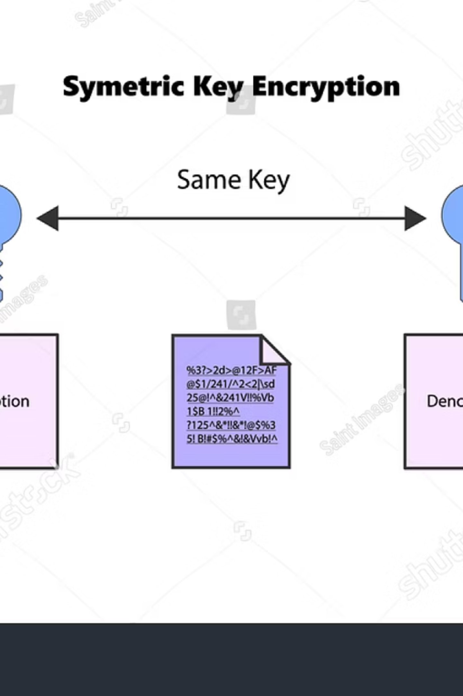
Symmetric vs Asymmetric Keys
AWS KMS supports both symmetric and asymmetric key types, offering flexibility for various cryptographic use cases. The choice between them depends on the specific operation you need to perform and your security requirements.
Symmetric Keys
A symmetric key uses a single key for both encryption and decryption. This means the same key that encrypts the data is also used to decrypt it. Symmetric encryption is generally faster and more efficient for encrypting large amounts of data. In AWS KMS, symmetric keys are the default and most commonly used key type, suitable for services like Amazon S3, RDS, and EBS for data at rest encryption.
When you request KMS to encrypt data, you send the data to KMS, and it encrypts it with your symmetric key within its HSMs. It then returns the ciphertext. For decryption, you send the ciphertext back to KMS, and it decrypts it using the same symmetric key.
Asymmetric Keys
Asymmetric keys involve a public/private key pair. The public key can be widely distributed and used for encryption or verifying digital signatures, while the private key must be kept secret and is used for decryption or creating digital signatures. Asymmetric keys are typically slower than symmetric keys but offer unique capabilities for secure communication and integrity verification.
AWS KMS supports asymmetric keys for advanced operations such as:
Digital Signatures: You can use the private key to sign data, and others can use the corresponding public key to verify the signature, ensuring data integrity and authenticity.
Encryption: Data can be encrypted with the public key and only decrypted with the private key, enabling secure key exchange or data transfer where the recipient is the only one who can decrypt.
Both symmetric and asymmetric key types are securely generated and stored within the FIPS 140-3 validated HSMs of AWS KMS, ensuring the highest level of protection for your cryptographic assets.

Slide 6




Powerful Cryptographic Operations
AWS KMS is not just for storing keys; it actively performs a wide range of cryptographic operations within its secure environment, eliminating the need for you to handle plaintext keys in your application code. This reduces the risk of accidental exposure and simplifies the implementation of strong cryptography.
Encrypt, Decrypt, Re-encrypt
Sign and Verify Messages
The most fundamental operations are encrypting and decrypting data. You can send plaintext data to KMS for encryption using your master keys, receiving ciphertext in return. Conversely, you can send ciphertext to KMS for decryption. Additionally, KMS supports re-encryption, allowing you to re-encrypt data with a new key without ever exposing the plaintext, which is crucial for key rotation or policy changes.
Leveraging asymmetric keys, KMS enables you to digitally sign messages and verify those signatures. Signing data with your private key provides undeniable proof of origin and ensures that the data has not been tampered with. The corresponding public key can then be used by any recipient to verify the integrity and authenticity of the message, critical for secure communication and immutable logs.
Generate and Verify HMAC Codes
Produce Secure Random Numbers
KMS can generate and verify Hash-based Message Authentication Codes (HMACs). HMACs provide data integrity and authentication by combining a cryptographic hash function with a secret key. This is useful for verifying the integrity of data in transit or at rest, ensuring that it hasn't been altered by unauthorized parties.
Many cryptographic applications require truly random numbers for tasks like generating session keys or initial vectors. AWS KMS offers a highly secure random number generator, backed by the same FIPS 140-3 validated HSMs. These numbers are cryptographically secure and suitable for all security-sensitive applications, ensuring the unpredictability required for strong cryptography.

Slide 7




Integration & Scalability
AWS KMS is engineered for the cloud, meaning it's built to be seamlessly integrated, highly available, and scalable to meet the demands of even the largest enterprises. Its design ensures that key management never becomes a bottleneck for your cloud operations.
Automatic Scaling
AWS KMS automatically scales to manage tens of thousands of keys and handle extremely high request volumes without any manual intervention from your side. Whether you have a handful of keys or millions of cryptographic operations per second, KMS dynamically adjusts its capacity to ensure consistent performance and availability, making it a truly serverless key management solution.
Multi-Region Keys
For global applications and disaster recovery strategies, AWS KMS offers multi-Region keys. These are identical keys in different AWS Regions that can be used interchangeably, simplifying encryption and decryption across geographically dispersed workloads. This capability enables you to build highly available and resilient architectures, ensuring business continuity even in the event of a regional outage.
Deep AWS Service Integration
AWS KMS provides deep, native integration with a vast array of AWS services. This means you can easily encrypt data at rest in services like Amazon S3, Amazon RDS, Amazon EBS, Amazon DynamoDB, and many others using your KMS keys, often with just a single configuration setting. This seamless integration ensures consistent encryption across your entire AWS footprint, simplifying compliance and reducing operational overhead.

Slide 8



Access Control & Auditing
Controlling who can access and use your encryption keys, and maintaining a clear record of all key operations, are critical components of a robust security posture. AWS KMS provides comprehensive features for both.
Fine-Grained Key Policies
Temporary Grants
Full Audit Trail with CloudTrail
KMS allows you to define granular key policies that specify exactly who (IAM users, roles, or even other AWS accounts) can perform specific cryptographic operations with a key. These policies operate at the key level, providing an additional layer of security beyond general IAM policies, ensuring that access to your most sensitive cryptographic assets is tightly controlled and adheres to the principle of least privilege.
For scenarios requiring time-limited access, KMS supports temporary grants. These allow you to provide scoped, time-limited permissions to use your keys without modifying the underlying key policy or IAM roles. This feature is ideal for operations that require elevated privileges for a short duration, enhancing security by minimizing the window of potential misuse.
Every API call made to AWS KMS is automatically logged by AWS CloudTrail. This provides a complete audit trail of all key usage and management activities, including who used a key, when, from where, and for what operation. This comprehensive logging is invaluable for security analysis, forensic investigations, and demonstrating compliance with regulatory requirements by providing irrefutable evidence of key access and usage.
Together, these features empower organizations to maintain strict control over their encryption keys and provide the necessary visibility for accountability and compliance.

Slide 9

Real-World Impact:
Securing Data at Scale
AWS KMS is not merely a theoretical security service; it's a practical, battle-tested solution relied upon by organizations globally to protect their most sensitive information.
Trusted by Millions
Ensuring Regulatory Compliance
Empowering Secure Application Development
Millions of AWS customers, from startups to large enterprises, rely on AWS KMS daily to protect their sensitive data across a wide array of applications and services. Its robust security, ease of integration, and scalability make it the go-to choice for safeguarding data in the cloud, underpinning critical business operations worldwide.
By providing hardware-backed, centralized key management, AWS KMS plays a vital role in helping organizations meet stringent regulatory compliance requirements such as GDPR, HIPAA, PCI DSS, and FedRAMP. It simplifies the process of proving control over encryption keys, which is often a key component of these compliance frameworks, allowing businesses to operate confidently in regulated industries.
AWS KMS empowers developers to build secure applications by abstracting away the complexities of cryptography. With simple API calls, applications can integrate powerful encryption, decryption, signing, and random number generation capabilities without ever handling the master keys directly. This accelerates secure development cycles and reduces the risk of cryptographic errors, leading to more secure software solutions.

Slide 10
Conclusion: Trust AWS KMS to Protect Your Keys and Data
AWS Key Management Service (KMS) stands out as an indispensable service for anyone serious about cloud security. It provides a robust, scalable, and auditable solution for managing cryptographic keys, which are the cornerstone of data protection.
1
2
3
Industry-Leading Security
Centralized, Scalable, Auditable
Foundation for Cloud Security
With FIPS 140-3 Level 3 validated HSMs and a design that ensures plaintext keys never leave the service, AWS KMS offers an unparalleled level of security for your encryption keys, safeguarding your data against the most sophisticated threats.
KMS provides a centralized control plane for all your keys, scales automatically to meet any demand, and offers a comprehensive audit trail via CloudTrail, giving you complete visibility and control over your cryptographic operations.
By seamlessly integrating with almost every AWS service, KMS serves as the fundamental building block for encryption in the AWS Cloud, enabling you to protect data at rest and in transit with ease and confidence.
Empower your cloud security strategy with AWS KMS — the ultimate solution for managing and protecting your encryption keys, ensuring the confidentiality, integrity, and availability of your data.
Thank you for your time.

